Slide 1
PYQ
GATE 2025 01 : 5 Marks 3 Question
GATE 2024 02 : 3 Marks 2 Question
GATE 2023 : 2 Marks 1 Question

Slide 2
GATE 2025 01

Slide 3

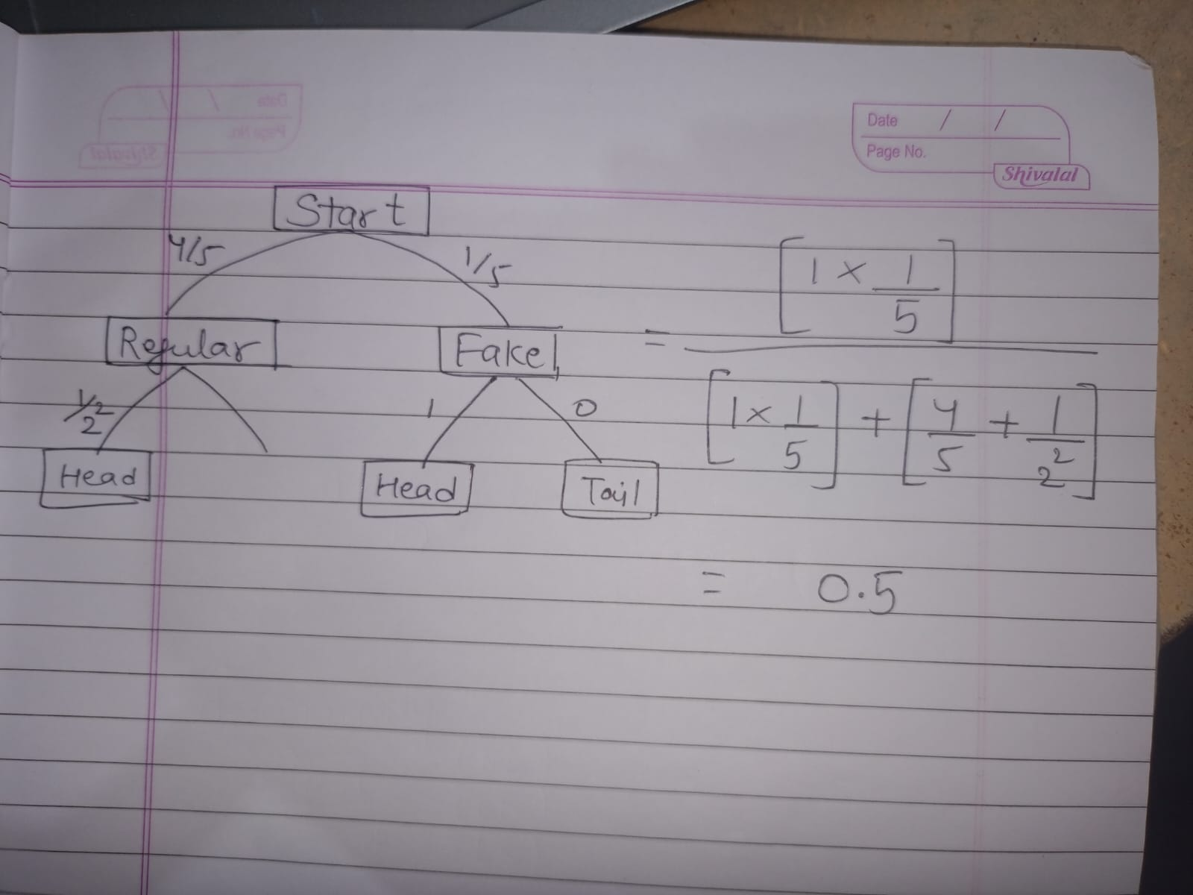

Slide 4

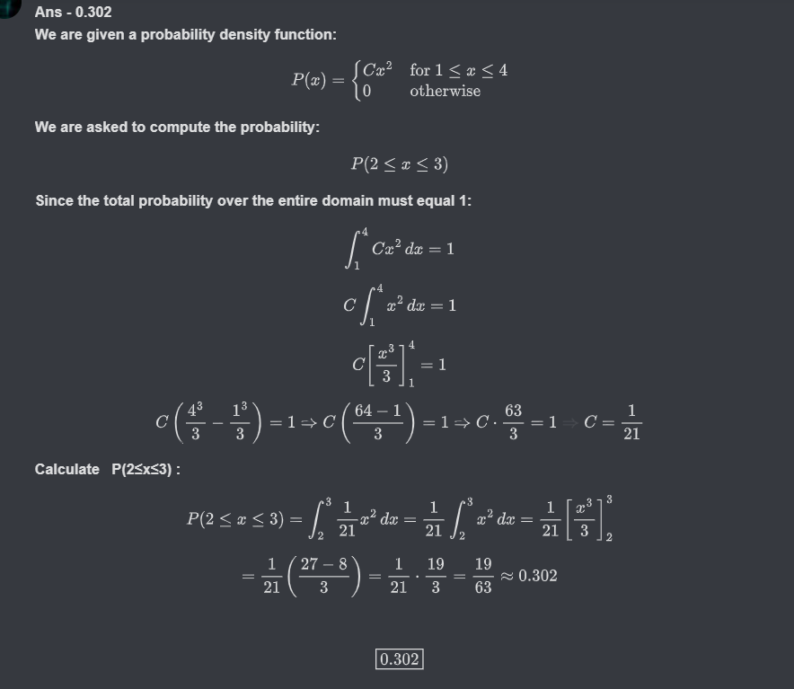

Slide 5
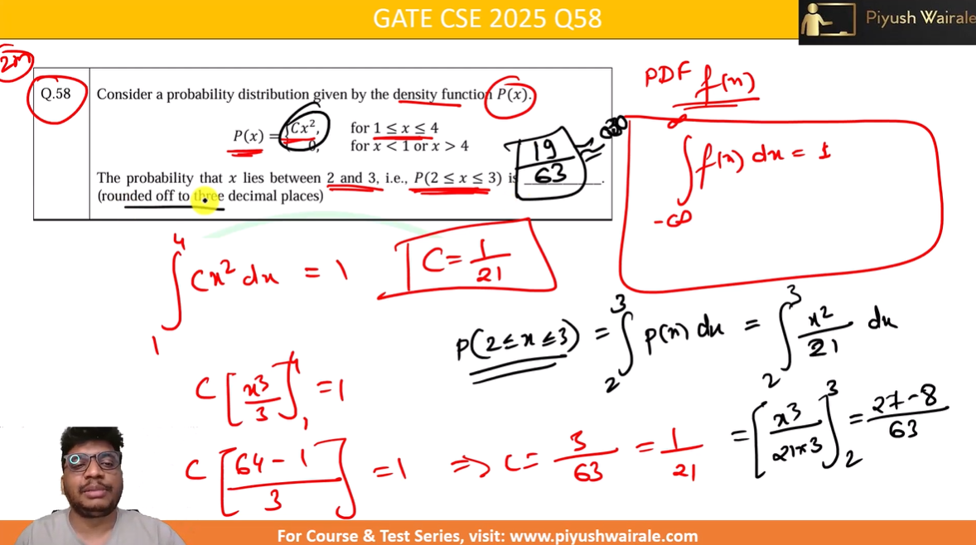

Slide 6

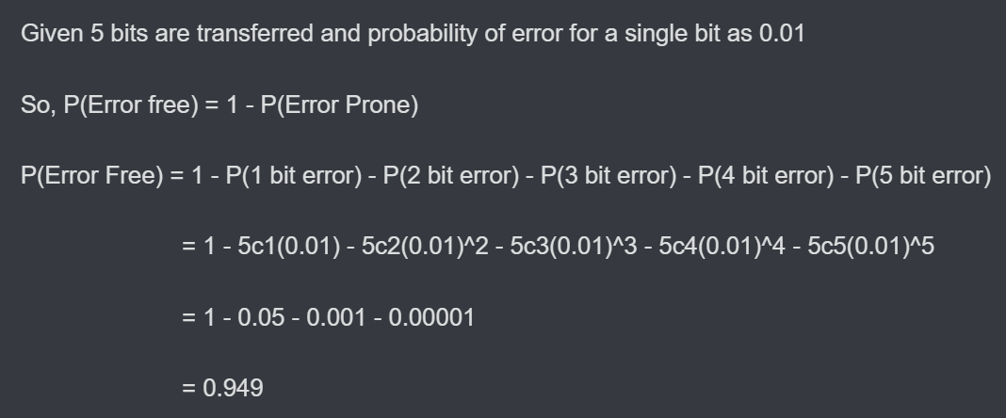
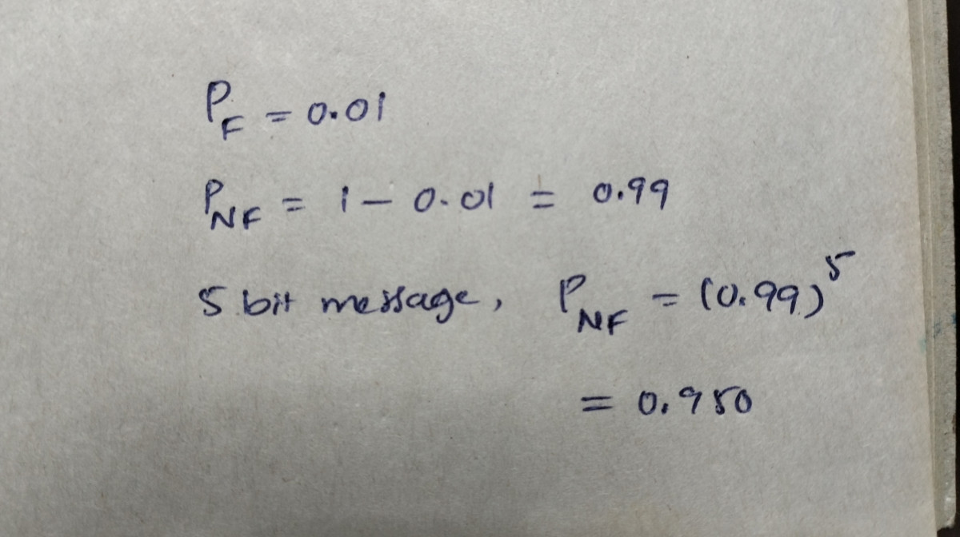
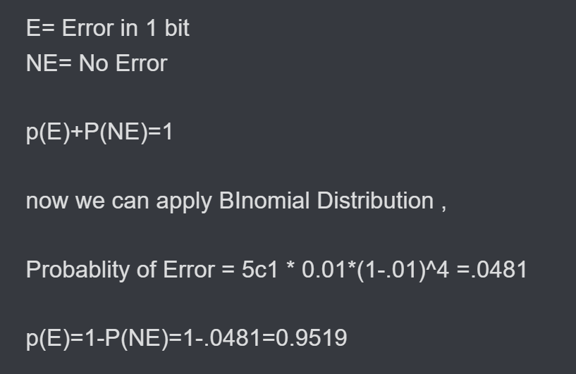
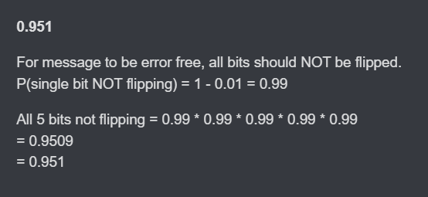

Slide 7
GATE 2024 02

Slide 8
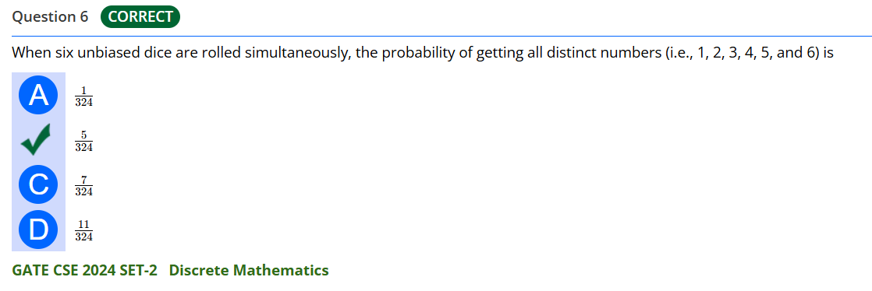
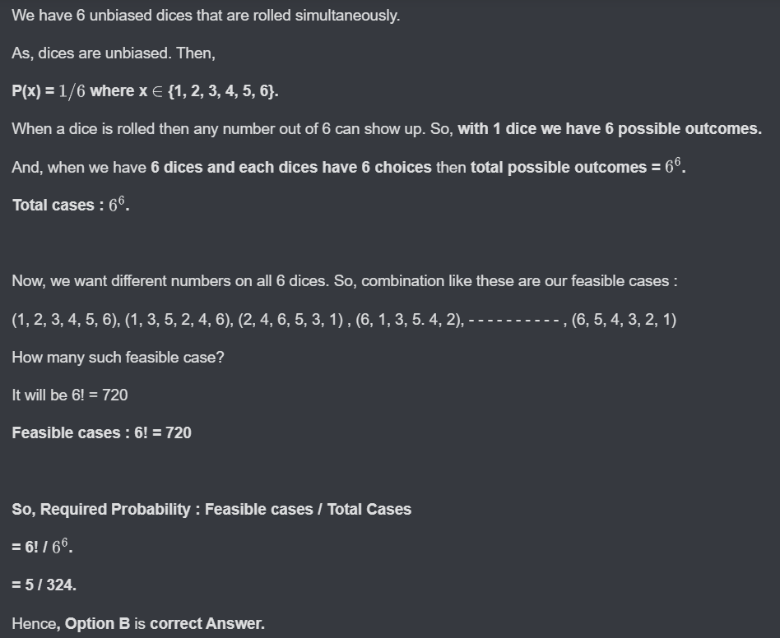

Slide 9

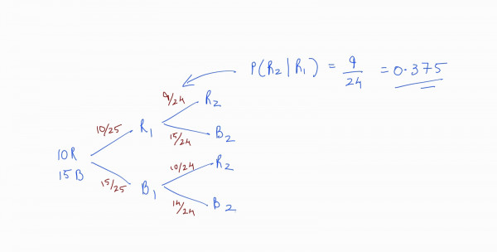

Slide 10
GATE 2023

Slide 11

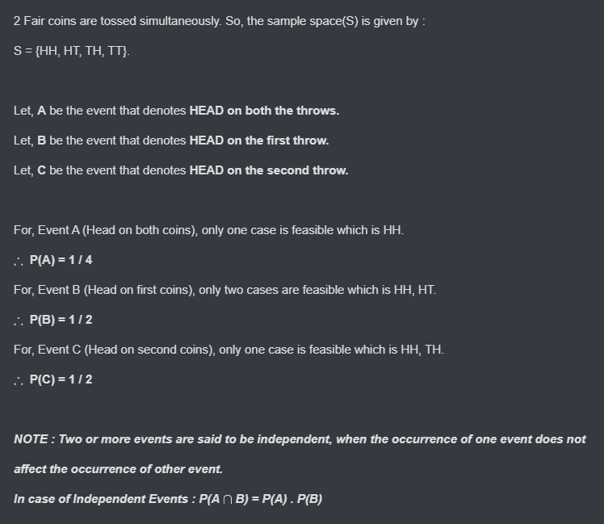

Slide 12
